Slide 1


Slide 2
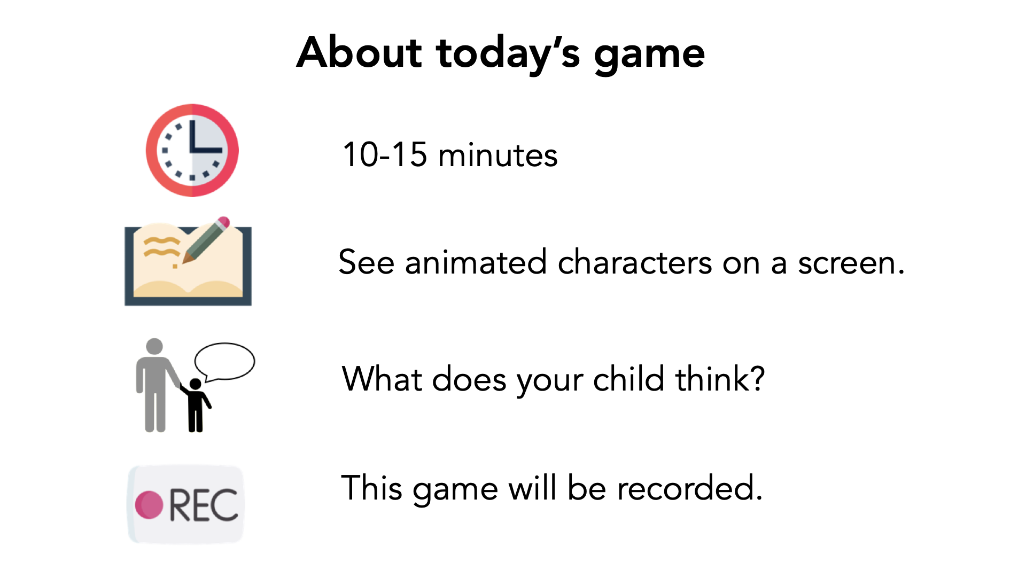

Slide 3
Verbal Consent
"I have read and understand the consent document. I am this child's parent or legal guardian and we both agree to participate in this study."

Slide 4


Slide 5

Notes:
Before we start, let's practice. This is Sam.

Slide 6


Notes:
Sam has two friends. This is Quinn. Quinn is Sam's best friend. And this is Rowan. Rowan is Sam's friend.

Slide 7

Which one is holding a ball?
Notes:
Look, one of them is holding a ball. Which one is holding a ball? [PRACTICE: response training; correct = Rowan (friend)]

Slide 8

Who would Sam want to share a juice box with one straw with?
Notes:
Sam has a juice box with one straw. Who do you think Sam would want to share the juice box with? Why? [PRACTICE / manipulation check: physical-intimacy item; expected = best friend (Quinn)]

Slide 9
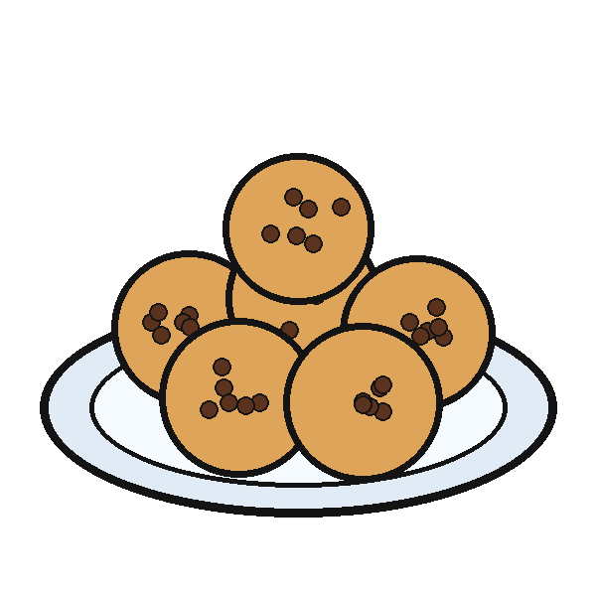
Who would Sam want to share cookies with?
Notes:
Sam has some cookies. Who do you think Sam would want to share the cookies with? Why? [PRACTICE / manipulation check: divisible item; no directional prediction]

Slide 10

Notes:
This is Casey. I'm going to tell you a story about Casey.

Slide 11
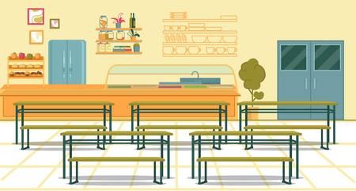

Notes:
This morning Casey felt sad, and Casey didn't know why.

Slide 12
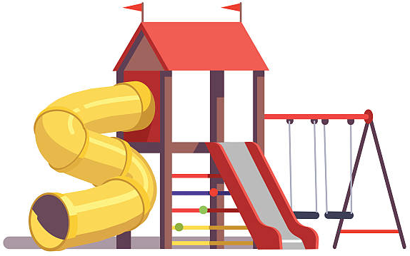

Notes:
And this afternoon Casey felt happy, and Casey didn't know why.

Slide 13


Notes:
After school, Casey saw a classmate named Blake. Blake said, "Hi Casey! How was school today?" Casey told Blake about feeling happy today.

Slide 14
Notes:
Casey did not tell Blake about feeling sad today.

Slide 15

Notes:
Then Casey saw another classmate named Morgan. Morgan said, "Hi Casey! How was school today?" Casey told Morgan about feeling sad today.

Slide 16
Notes:
Casey did not tell Morgan about feeling happy today.

Slide 17

Notes:
Which classmate did Casey tell about feeling sad today? [memory check]

Slide 18
Notes:
Which classmate did Casey tell about feeling happy today? [memory check]

Slide 19
Who do you think Casey is better friends with?
Notes:
Who do you think Casey is better friends with? Why? [PRIMARY DV]

Slide 20

Notes:
Who do you think Casey would want to share a single ice cream cone with? Why?

Slide 21

Notes:
Who do you think Casey would want to share candy with? Why?

Slide 22

Notes:
This is Percy. I'm going to tell you a story about Percy.

Slide 23
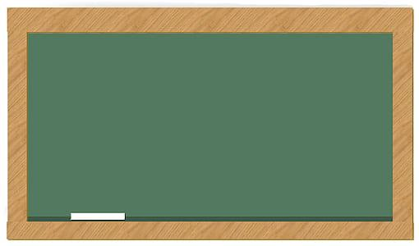

Notes:
Percy feels sad today, and Percy doesn't know why.

Slide 24
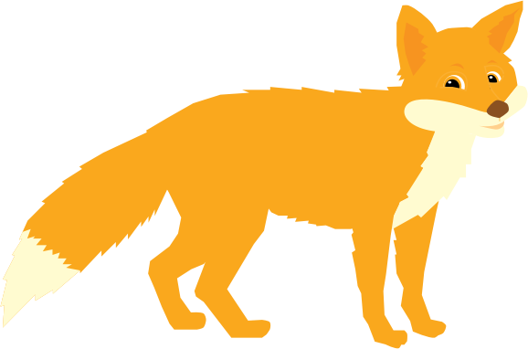

Notes:
In school today, Percy learned that foxes move without making any sound.

Slide 25

Notes:
After school, Percy saw a classmate named Avery. Avery said, "Hi Percy! How was school today?" Percy told Avery about how foxes move without making any sound.

Slide 26
Notes:
Percy did not tell Avery about feeling sad today.

Slide 27

Notes:
Then Percy saw another classmate named Orin. Orin said, "Hi Percy! How was school today?" Percy told Orin about feeling sad today.

Slide 28
Notes:
Percy did not tell Orin about how foxes move without making any sound.

Slide 29
Notes:
Which classmate did Percy tell about feeling sad today? [memory check]

Slide 30
Notes:
Which classmate did Percy tell the fact about foxes? [memory check]

Slide 31
Who do you think Percy is better friends with?
Notes:
Who do you think Percy is better friends with? Why? [PRIMARY DV]

Slide 32
Notes:
Who do you think Percy would want to share a single ice cream cone with? Why?

Slide 33
Notes:
Who do you think Percy would want to share candy with? Why?

Slide 34

Notes:
This is Kendall. I'm going to tell you a story about Kendall.

Slide 35

Notes:
Kendall feels happy today, and Kendall doesn't know why.

Slide 36
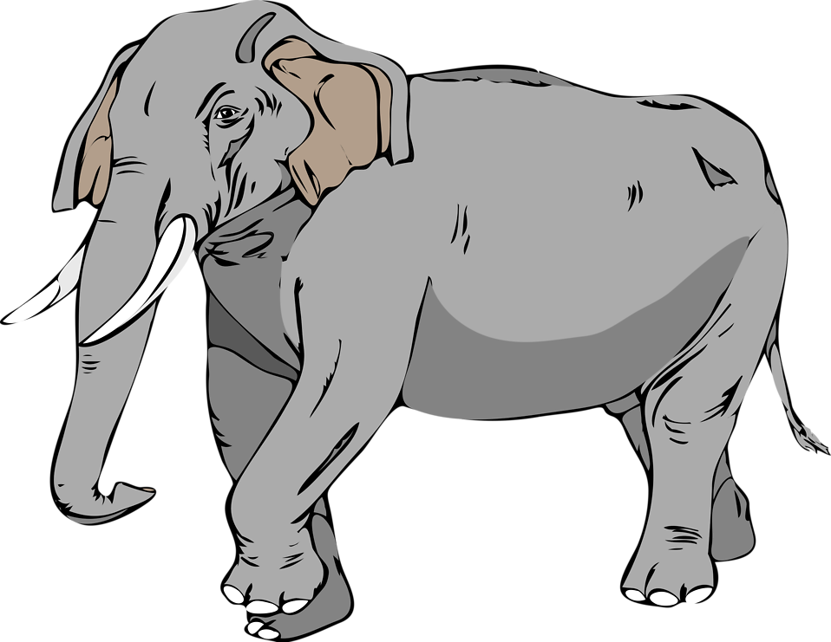
Notes:
In school today, Kendall learned that elephants move mostly in the morning.

Slide 37

Notes:
After school, Kendall saw a classmate named Riley. Riley said, "Hi Kendall! How was school today?" Kendall told Riley about how elephants move mostly in the morning.

Slide 38
Notes:
Kendall did not tell Riley about feeling happy today.

Slide 39

Notes:
Then Kendall saw another classmate named Cameron. Cameron said, "Hi Kendall! How was school today?" Kendall told Cameron about feeling happy today.

Slide 40
Notes:
Kendall did not tell Cameron about how elephants move mostly in the morning.

Slide 41
Notes:
Which classmate did Kendall tell about feeling happy today? [memory check]

Slide 42
Notes:
Which classmate did Kendall tell the fact about elephants? [memory check]

Slide 43
Who do you think Kendall is better friends with?
Notes:
Who do you think Kendall is better friends with? Why? [PRIMARY DV]

Slide 44
Notes:
Who do you think Kendall would want to share a single ice cream cone with? Why?

Slide 45
Notes:
Who do you think Kendall would want to share candy with? Why?

Slide 46

Notes:
This is Jamie. I'm going to tell you a story about Jamie.

Slide 47

Notes:
In school today, Jamie found out that owls are their favorite animal.

Slide 48
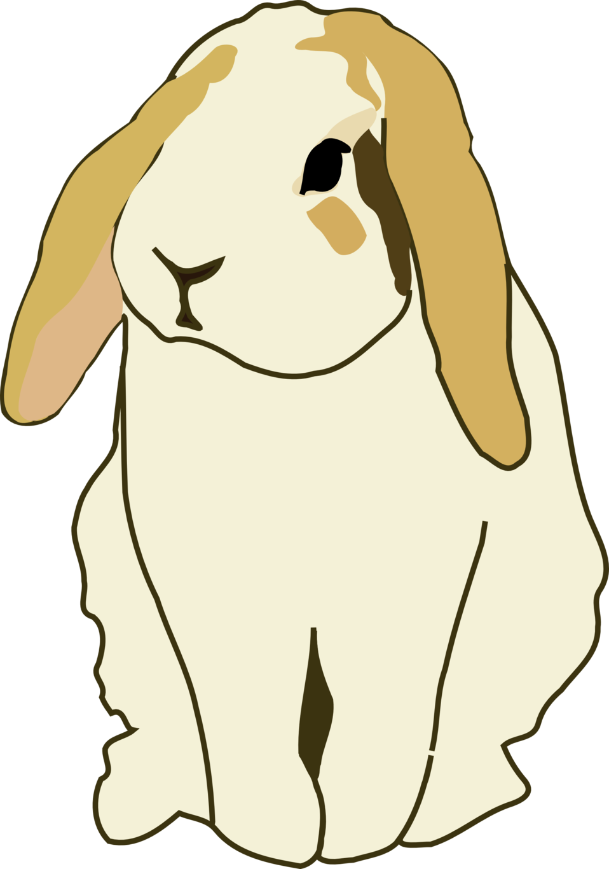
Notes:
In school today, Jamie learned that rabbits move by hopping on their back legs.

Slide 49

Notes:
After school, Jamie saw a classmate named Elliot. Elliot said, "Hi Jamie! How was school today?" Jamie told Elliot about how rabbits move by hopping on their back legs.

Slide 50
Notes:
Jamie did not tell Elliot that owls are their favorite animal.

Slide 51

Notes:
Then Jamie saw another classmate named Parker. Parker said, "Hi Jamie! How was school today?" Jamie told Parker that owls are their favorite animal.

Slide 52
Notes:
Jamie did not tell Parker about how rabbits move by hopping on their back legs.

Slide 53
Notes:
Which classmate did Jamie tell that owls are their favorite animal? [memory check]

Slide 54
Notes:
Which classmate did Jamie tell the fact about rabbits? [memory check]

Slide 55
Who do you think Jamie is better friends with?
Notes:
Who do you think Jamie is better friends with? Why? [PRIMARY DV]

Slide 56
Notes:
Who do you think Jamie would want to share a single ice cream cone with? Why?

Slide 57
Notes:
Who do you think Jamie would want to share candy with? Why?

Slide 58
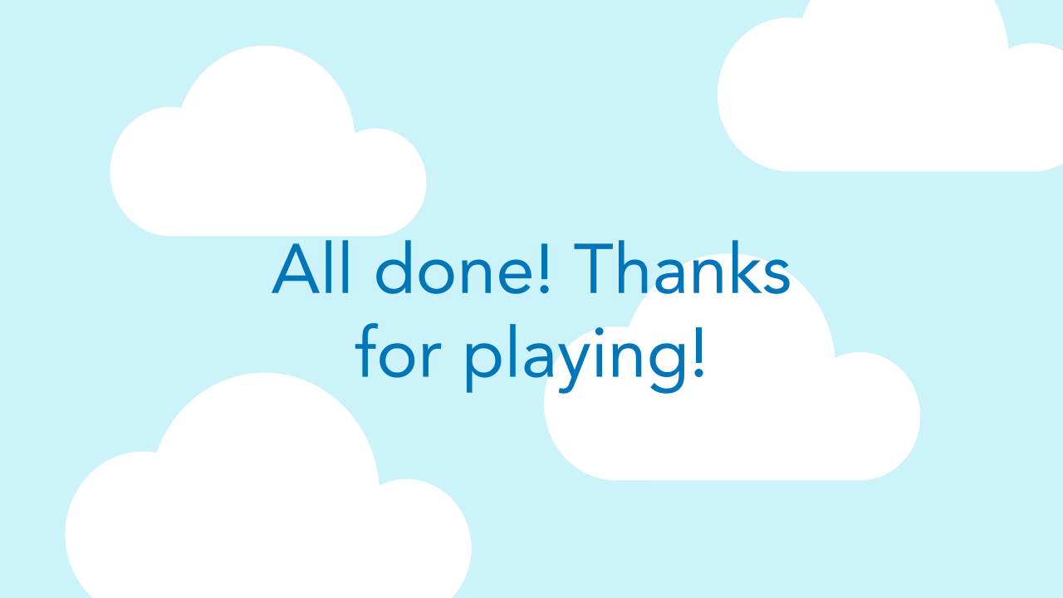

Slide 59
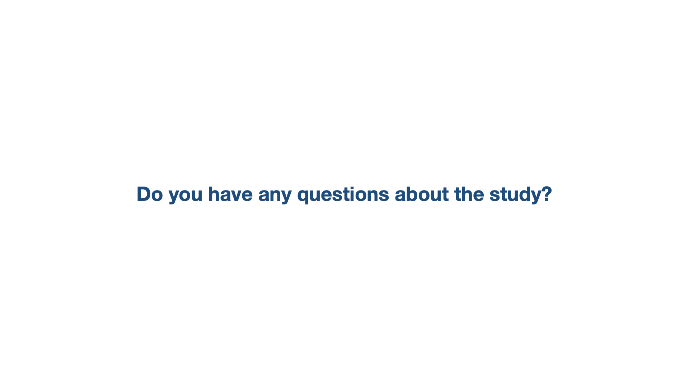

Slide 60
